Slide 1
Device Tree
Ruchika Gupta

Slide 2
Background
Device Tree – Overview
Standard Properties
Device Node requirements
Device Bindings
Interrupt Mapping
Passing DT Information to the OS
Flattened Device tree
Device Tree Compiler
Client Program Boot Requirements
SMP CPU Boot requirements

Slide 3
Background
Firmware role
  OS Loader
  Hardware abstraction
  Hardware initialization
  Hardware configuration
….
Problem: Varied firmware environment found in embedded platforms
Firmware provides the OS with minimum configuration information
  Ethernet MAC addresses
  Size of RAM
  Processor speed
Goal : Standardize information passing from firmware to OS
Notes:
BM PowerPC pSeries: Open Firmware
• Embedded PowerPC: PIBS, U-Boot, many others
• Apple PowerPC: Open Firmware
• Sun SPARC: Open Firmware used in Sun Solaris and Sun Linux products
• HP: proprietary
• Intel: compatible BIOS, EFI, ACPI, UEFI

Slide 4
What is a Device Tree
Device tree provides a way to:
  Represent hardware configuration in hierarchical way (each node except root has a parent)
  Pass information from firmware to OS
An ePAPR-compliant device tree describes device information in a system that cannot be dynamically detected by a client program.
ePAPR (Embedded Power Architecture Platform Requirements) available 4Q2007
  Main effort in standardization of firmware to OS interface
Notes:
Power.org (www.power.org)
Power.org's mission is to develop, enable and promote Power Architecture technology
Supports a number of standard and specification initiatives
ePAPR (Embedded Power Architecture Platform Requirements) available 4Q2007
Main effort in standardization of firmware to OS interface
ePAPR 1.0 addresses only boot services
How firmware initializes hardware and boots an OS
How configuration information is passed to OS, Device Tree (DT)
Multi core considerations
32-bit and 64-bit considerations
ePAPR is loosely related to IEEE 1275 (Open Firmware)
Takes device tree structure
Draws heavily on on-going work being done in the PowerPC Linux community

Slide 5
Nodes
Device tree is made of nodes that describe the physical devices in a system
  Each node has property/value pairs that describe the characteristics of the device being represented.
  Each node has exactly one parent except for the root node, which has no parent

Slide 6
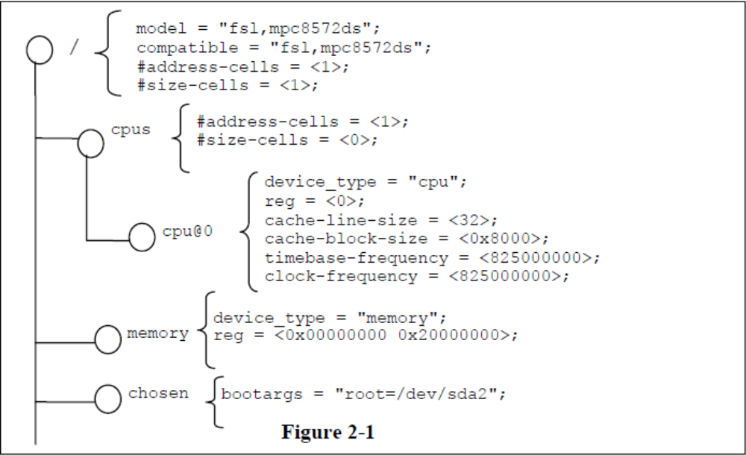
Example representation of a simple device tree

Slide 7
Node names
Each node in the device tree has a name according to the following convention:
name@unit-address
The name component specifies the name of the node
The unit-address component of the name is specific to the bus type on which the node sits.
-- unit-address must be unique
-- should match the first address specified in the reg property of the node.

Slide 8
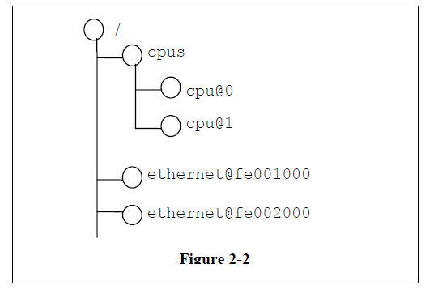
Example
• The nodes with the name cpu are distinguished by their unit-address values of 0 and 1.
• The nodes with the name ethernet are distinguished by their unit-address values of FE001000 and FE002000.

Slide 9
Properties
  Each node has property/value pairs that describe the characteristics of the device being represented
  A property value is an array of zero or more bytes that contain information associated with the property
  Properties might have an empty value if conveying true-false information. In this case, the presence or absence of the property is sufficiently descriptive.
  Node values can be: numeric, strings, list of strings, tables, other structured information

Slide 10
Properties Values
<u32> -- A 32-bit integer in big-endian format .
Example: the 32-bit value 0x11223344 would be represented in memory as:
address 0x11
address+1 0x22
address+2 0x33
address+3 0x44
<u64> -- A 64-bit integer in big-endian format
Example: the 64-bit value 0x1122334455667788 would be represented as two cells as: <0x11223344 0x55667788>.
<string> -- Strings are printable and NULL-terminated
<phandle> -- Reference to another node in device tree
<stringlist> -- A list of <string> values concatenated together

Slide 11
Standard Properties
Compatible
Phandle
reg
#address-cells and #size-cells
ranges
status

Slide 12
Standard Properties
compatible
Property: compatible
Value type: <stringlist>
Description:
-- one or more strings that define the specific programming model for the device.
-- used by a client program for device driver selection.
-- List of strings from from most specific to most general.
The recommended format is “manufacturer,model”, where manufacturer is a string describing the name of the manufacturer, and model specifies the model number.
Example:
compatible = “fsl,mpc8641-uart”, “ns16550";
In this example, an operating system would first try to locate a device driver that supported fsl,mpc8641-uart. If a driver was not found, it would then try to locate a driver that supported the more general ns16550 device type

Slide 13
Standard Properties
phandle
Property: phandle
Value type: <u32>
Description:
-- specifies a numerical identifier for a node that is unique within the device tree.
-- used by other nodes that need to refer to the node associated with the property.
Example:
See the following device tree excerpt:
  pic@10000000 {
    phandle = <1>;
    interrupt-controller;
  };
A phandle value of 1 is defined. Another device node could reference the pic node with a phandle value of 1:
interrupt-parent = <1>;

Slide 14
Standard Properties
reg
Property: reg
Value type: <prop-encoded-array> encoded as arbitrary number of (address,length) pairs.
Description:
-- describes the address and length of a device’s memory mapped register space within its parent’s address space.
-- The value is a <prop-encoded-array>, composed of an arbitrary number of pairs of address and length, <address, length>.
-- Depends on #address-cells and #size-cells properties in the parent of the device node.
Example:
Suppose a device within a system-on-a-chip had two blocks of registers—a 32-byte block at offset 0x3000 in the SOC and a 256-byte block at offset 0xFE00. The reg property would be encoded as follows (assuming #address-cells and #size-cells values of 1):
reg = <0x3000 0x20 0xFE00 0x100>;

Slide 15
Standard Properties
#address-cells and #size-cells
Property: #address-cells, #size-cells
Value type: <u32>
Description:
-- may be used in any device node that has children in the device tree hierarchy
-- describe how child device nodes should be addressed.
-- #address-cells the number of <u32> cells used to encode the address field in a child node’s reg property.
-- #size-cells property defines the number of <u32> cells used to encode the size field in a child node’s reg property.
The #address-cells and #size-cells properties are not inherited from ancestors in the device tree. They shall be explicitly defined.
If missing, a client program should assume a default value of 2 for #address-cells, and a value of 1 for #size-cells.

Slide 16
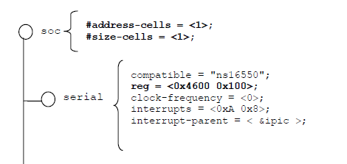
Example
The #address-cells and #size-cells properties of the soc node are both set to 1.
The serial device reg property necessarily follows this specification set in the parent (soc) node—the address is represented by a single cell (0x4600), and the size is represented by a single cell (0x100).

Slide 17
Standard Properties
Ranges
Property: ranges
Value type: <empty> or <prop-encoded-array> encoded as arbitrary number of triplets of (child-bus-address, parent-bus-address, length).
Description:
Describes the address mapping of a memory-mapped bus.
provides a means of defining a mapping or translation between the physical address space of the bus (the child address space) and that of the bus node’s parent (the parent address space).
If the property is defined with an <empty> value, it specifies that the parent and child address space is identical, and no address translation is required.
If the property is not present in a bus node, it is assumed that no mapping exists between children of the node and the parent address space.

Slide 18
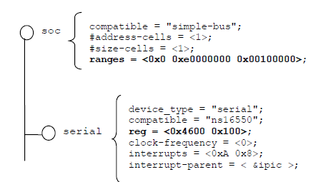
Example
the soc node specifies a ranges property of
<0x0 0xe0000000 0x00100000>;
This property value specifies that for an 1024KB range of address space, a child node addressed at physical 0x0 maps to a parent address of physical 0xe0000000.
With this mapping, the serial device node can be addressed by a load or store at address 0xe0004600, an offset of 0x4600 (specified in reg) plus the 0xe0000000 mapping specified in ranges.

Slide 19
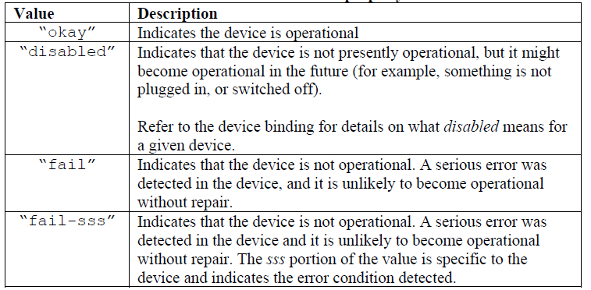
Standard Properties
status
Property: status
Value type: <string>
Description: -- indicates the operational status of a device.

Slide 20
Device Nodes Requirements
All device trees shall have a root node and the following nodes shall be present at the root of all device trees:
cpu node
  Describes CPUs or cores in the system
  Standard properties include: reg, clock-frequency, reservation-granule-size, etc
  TLB, L1 cache, as well as multi level and shared caches can be described
memory node
  Required for all DT
  Describes physical memory layout of the system
  Only read/write memory should be described using memory node
Number of other device nodes
  See Documentation/powerpc/booting-without-of.txt file in Linux source code
  Various bindings to “IEEE 1275” standard
  ePAPR on Power.org WEB site, when available

Slide 21
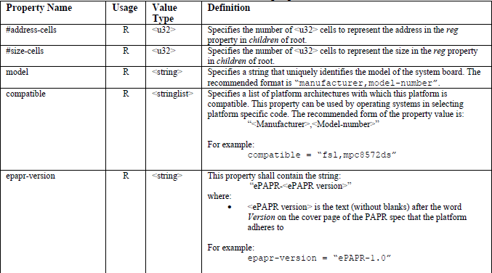
Root Node
The full path to the root node is /.

Slide 22
Alias Node
A client program or any device tree property, may use an alias property name to refer to a full device path as all or part of its string value. A client program, when considering a string as a device path, shall detect and use the alias.
Example:
aliases {
serial0 = "/simple-bus@fe000000/serial@llc500";
ethernet0 = "/simple-bus@fe000000/ethernet@31c000";
}
Given the alias serial0, a client program can look at the /aliases node and determine the alias refers to the device path /simple-bus@fe000000/serial@llc500.

Slide 23
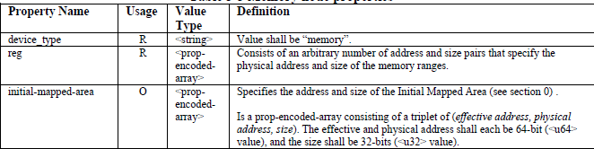
Memory node
Given a 64-bit PowerPC system with the following physical memory layout:
• RAM: starting address 0x0, length 0x80000000 (2GB)
• RAM: starting address 0x100000000, length 0x100000000 (4GB)
#address-cells = 2 and a #size-cells = 2:
memory@0 {
device_type = "memory";
reg = <0x000000000 0x00000000 0x00000000 0x80000000
0x000000001 0x00000000 0x00000001 0x00000000>;
};

Slide 24
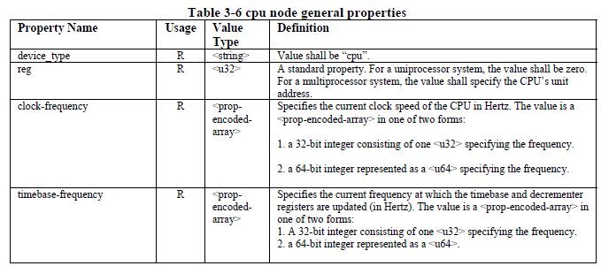
CPU Node
-- container for child cpu nodes which represent the systems CPUs
-- node name is cpus

Slide 25
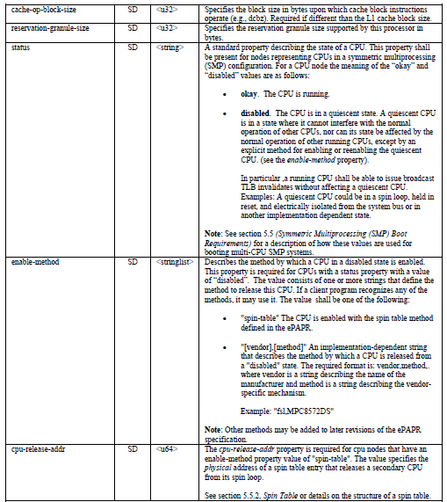

Slide 26
Interrupt Mapping
Interrupt signals can originate from and terminate on any device in a machine
Interrupt signals are expressed as links between nodes independent of the tree
Four properties are used to describe interrupt connections:
    interrupt-controller - An empty property declaring a node as a device that receives interrupt signals
    #interrupt-cells - This is a property of the interrupt controller node. It states how many cells are in an interrupt specifier for this interrupt controller (Similar to #address-cells and #size-cells).
    interrupt-parent - A property of a device node containing a phandle to the interrupt controller that it is attached to. Nodes that do not have an interrupt-parent property can also inherit the property from their parent node.
    interrupts - A property of a device node containing a list of interrupt specifiers, one for each interrupt output signal on the device.

Slide 27
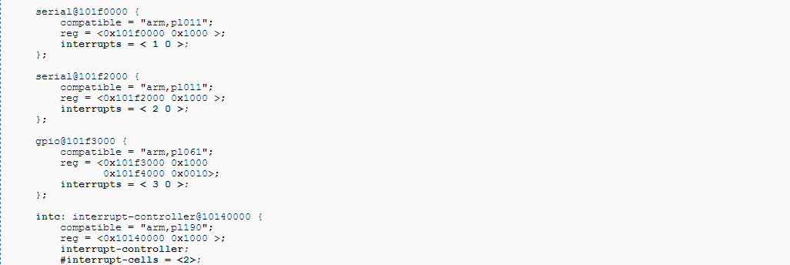
:
The machine has a single interrupt controller, interrupt-controller@10140000.
The label 'intc:' has been added to the interrupt controller node, and the label was used to assign a phandle to the interrupt-parent property in the root node. This interrupt-parent value becomes the default for the system because all child nodes inherit it unless it is explicitly overridden.
Each device uses an interrupt property to specify a different interrupt input line.
#interrupt-cells is 2, so each interrupt specifier has 2 cells. This example uses the common pattern of using the first cell to encode the interrupt line number, and the second cell to encode flags such as active high vs. active low, or edge vs. level sensitive. For any given interrupt controller, refer to the controller's binding documentation to learn how the specifier is encoded.

Slide 28
Device Bindings
The compatible property of a device node describes the specific binding (or bindings) to which the node complies
Bindings may be defined as extensions of other each.
For example a new bus type could be defined as an extension of the simple-bus binding
compatible value -- simple-bus
System-on-a-chip processors may have an internal I/O bus that cannot be probed for devices. The devices on the bus can be accessed directly without additional configuration required.

Slide 29
Creating a new device tree representation for a device
Some recommended practices include:
1. Define a compatible string
.
2. Use the standard properties as applicable for the new device.
3. Use the conventions if the new device fits into one the ePAPR defined device classes.
4. If new properties are needed by the binding, the recommended format for property names is: “<company>,<property-name>”, where <company> is an OUI or short unique string that identifies the creator of the binding.

Slide 30
Devices
Devices that can be discovered dynamically generally don’t have to be included
    USB devices generally don’t have to be included since they can be easily enumerated
    PCI host bridges generally have to be included
    Devices with atypical interrupt routing should be included
Nodes representing devices and buses must have “compatible” property
    Example: compatible = “"ibm,uic-440gp", "ibm,uic“, compatible = “ns16550”

Slide 31
Passing DT Information to the OS
Device Tree information needs to be passed to the OS (or bootstrap) code
    OS receives flattened (binary) representation of the Device Tree from bootstrap code (uBoot)
  Binary representation of the device tree passed directly to bootstrap code
  Firmware contains largely static binary representation of the device tree
  Firmware updates several values in the device tree (ex. network hardware address)
  How is it done in our cases ?
  bootm <kernel_addr> <initrd_addr> <dev_tree_addr>

Slide 32
Flattened Device Tree structure
Flattened DT represents DT in a compact binary format
  Relocatable. Can be moved without knowledge of the internals (no pointers)
  Permits easy insert/delete/update operations (limits use of internal offsets)
  Compact. Use of common string block.
  Easily parsed by software
Flattened DT made out of 4 sections
  Header. Provides offsets to other sections and other basic information (boot CPU ID)
  Memory reserve table (information contained in /memreserve node)
  String block. All the ASCII string representing property names are contained in this section
  Structure block. Contains structured data representing the DT

Slide 33
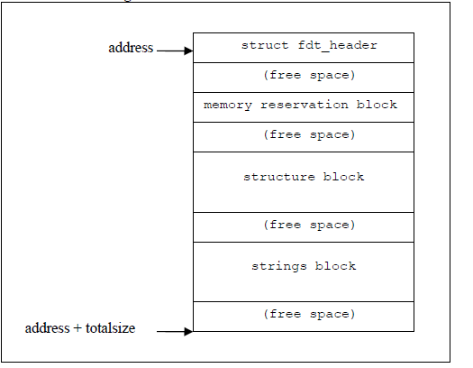
Flattened Device tree

Slide 34
Device Tree Compiler
Constructing binary representation of the DT by hand is error prone
Device Tree Compiler (DTC) converts various DT representation
    Input format
    Text format (see page 14), binary representation (see page 16)
    Filesystem (format in the /proc/device-tree filesystem)
    Output format: binary representation, text format, assembler source
Sample device tree files can be found under arch/powerpc/boot/dts
DTC package contains library (libfdt) of functions that manipulate binary DT

Slide 35
Accessing DT Information within OS
Bootstrap code uses DT
  Serial port type, location
  Host bridge setup
  finddevice(), getprop() calls used to retrieve information from the DT
The pointer to DT binary representation is passed in r3 to the Linux kernel
  Rich set of API calls to retrieve information from the DT (arch/powerpc/kernel/prom.c)
  Some API calls also included in arch/powerpc/kernel/prom_parse.c
  of_find_compatible_node(), find node based in token in “compatible” property
  of_get_property(), find property given node and property name
  of_find_node_by_type(), searched for node given “device_type” property
  of_translate_address(), translates address from DT to CPU physical address:
At run time the DT information can be accessed through /proc/device-tree FS

Slide 36
ePAPR complaint boot program
ePAPR compliant client

Slide 37
Client Program Boot Requirements
  Boot CPU -- CPU on which control is transferred from the boot program to a client program.
  Secondary CPU -- Other CPUs that belong to the client program
  A boot program shall load a device tree image into the client program’s memory before transferring control to the client on the boot cpu.

Slide 38
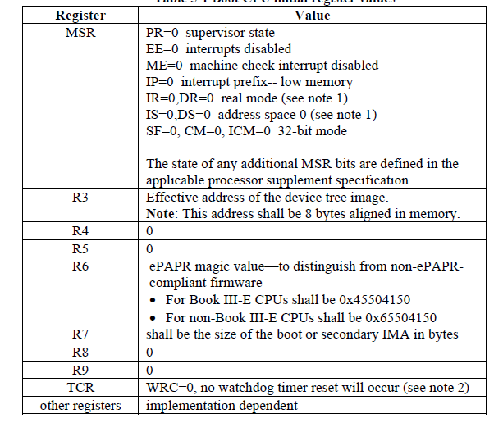
Boot CPU Initial Register Values

Slide 39
Initially Mapped Area (IMA)
A client program’s IMA is a region of memory that contains the entry points for a client program.
Requirements
virtually and physically contiguous
start at effective address zero (0) which shall be mapped to a naturally aligned physical address
The mapping shall not be invalidated except by a client program’s explicit action (i.e., not subject to broadcast invalidates from other CPUs)
may be mapped by a TLB entry larger than the IMA size, provided the MMU guarded attribute is set (G=1)
may span multiple TLB entries.

Slide 40
Boot CPU Entry Requirements for IMAs
1. The Boot IMA (BIMA) mapping in the MMU shall map effective address 0 to the lowest physical memory address available.
2. All PT_LOAD segments shall be loaded into BIMA.
3. The device tree shall be loaded into the BIMA (with the address in r3).
4. Other mappings may be present in Address Space (AS) 0.
5. No mappings shall be present in Address Space (AS) 1.
6. r7 shall contain the size of the BIMA.
7. The MMU mappings for the BIMA and all IIOs shall be such that the TLBs can accommodate a reasonable number of additional mappings.

Slide 41
Secondary CPU Entry Requirements for IMAs
1. The Secondary IMA (SIMA) mapping in the MMU shall map effective address 0 to the entry_addr field in the spin table, aligned down to the SIMA size.
2. The SIMA shall have a minimum size of 4KB.
3. Other mappings may be present in Address Space (AS) 0.
4. No mappings shall be present in Address Space (AS) 1.
5. r7 shall contain the size of the SIMA.
6. The MMU mapping for the SIMA shall be such that the TLBs can accommodate a reasonable number of additional mappings.
Notes:
• A client program should physically align its secondary entry points so that the 4 KB SIMA size requirement (see requirement #2) is sufficient to ensure that enough code is in the SIMA to transfer the secondary CPU to the client’s MMU domain (which will typically involve a temporary mapping in AS1)
• Boot programs will typically need to establish the SIMA mapping after leaving the spin loop and reading the entry_addr spin table field. However, this mapping might not be necessary if, for example, the boot program always uses a SIMA that covers all RAM.

Slide 42
Symmetric Multiprocessing (SMP) Boot Requirements
Control transferred to boot CPU
Secondary CPUs are in a quiescent state
The status property of the quiescent CPU’s cpu node in the device tree shall have a value of “disabled”
Secondary CPUs may be started using the spin table or implementation-specific mechanisms
Notes:
quiescent state -- state where it cannot interfere with the normal operation of other CPUs, nor can its state be affected by the normal operation of other running CPUs, except by an explicit method for enabling or re-enabling the quiescent CPU

Slide 43
Spin Table
The boot program places all secondary CPUs into a loop where each CPU spins until the branch_address field in the spin table is updated specifying that the core is released.
A spin table is a table data structure consisting of 1 entry per CPU where each entry is defined as follows:
struct {
uint64_t entry_addr;
uint64_t r3;
uint32_t rsvd1;
uint32_t pir;
};
Initial value of entry addr = 1
Notes:
The spin table fields are defined as follows:
• entry_addr. Specifies the physical address of the client entry point for the spin table code to branch to.
• r3. Contains the value to put in the r3 register at secondary cpu entry. The high 32-bits are ignored on 32-bit chip implementations. 64-bit chip implementations however shall load all 64-bits
• pir. Contains a value to load into the PIR (processor identification) register for those CPUs with writable PIR.

Slide 44
Boot program requirements
Before starting a client program on the boot cpu, the boot program shall set certain properties in the device tree passed to the client as follows:
Each secondary CPU’s cpu node shall have a status property with a value of “disabled”.
Each secondary CPU’s cpu node shall have an enable-method property.
For each secondary cpu node with an enable-method value of “spin-table”, the cpu node shall have a cpu-release-addr property that describes the address of the applicable spin table entry to release the CPU.

Slide 45
Client program requirements
When a client program is started on its boot CPU, it is passed
device tree that specifies all secondary CPUs that belong to the client
state of those CPUs
spin table entry to release each CPU
cpu-release-addr property -- physical address of the spin table entry for the CPU

Slide 46
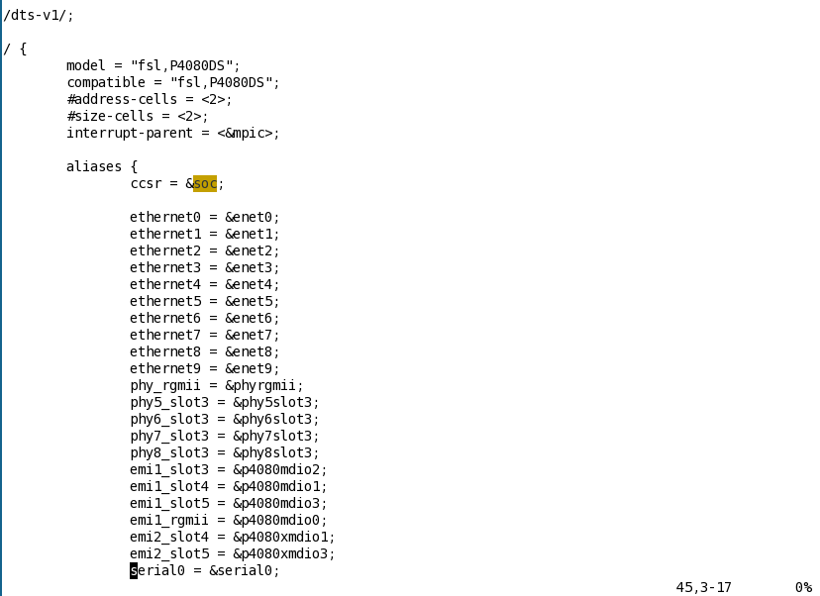
P4080ds.dts

Slide 47
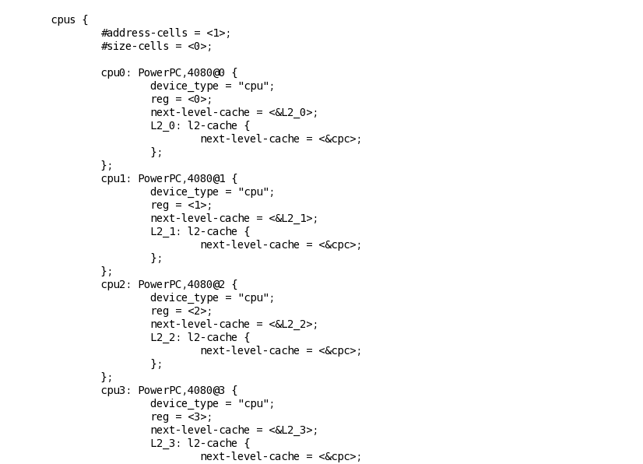
cpus node in p4080ds.dts

Slide 48

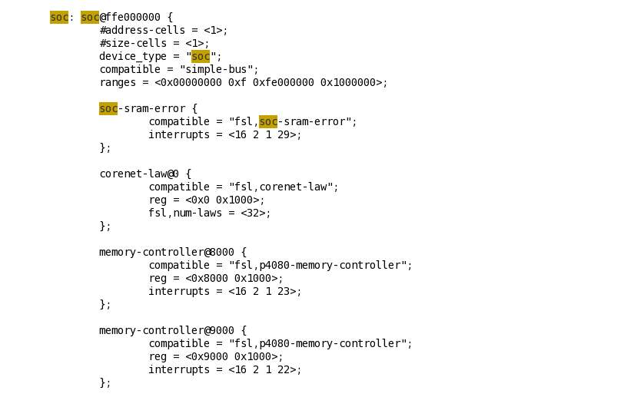
Soc node in p4080ds.dts

Slide 49
References
1. Power.org Standard for Embedded Power Architecture Platform Requirements (ePAPR). power.org, 2008.
2. “Booting the Linux/ppc kernel without Open Firmware”, Documentation/powerpc/bootingwithout-of.txt in Linux source code
3. David Gibson, Benjamin Herrenschmidt “Device Trees Everywhere”, OzLabs, 13 February2006, <http://www.ozlabs.com/~dgibson/home/papers/dtc-paper.pdf>

